Slide 1
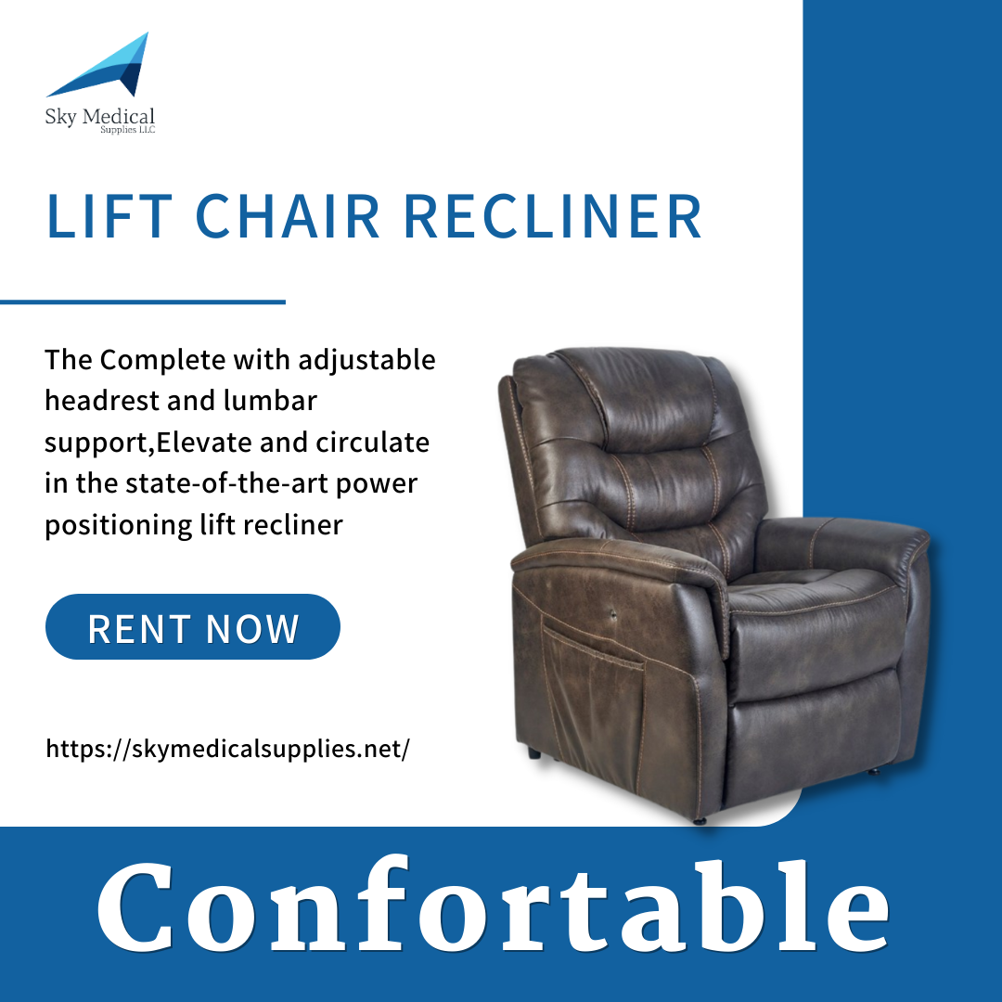
Built upon a legacy of reliable, field-proven concentrator models, the DeVilbiss 5 Liter Oxygen Concentrator was designed with enhanced quality, durability, and simplicity in mind.
👉 Do you have an interest in our products? visit our store or at 8340 Northfield blvd or our website https://simplyrenting.com/
.
.
.
#skymedical #simplyrenting #medicalsupplies #medicalequipmentsupplies #toptiermedicalsupplies #medicalsuppliesstore #medicalsuppliesretailstore #medical #health #medicallife #staysafe #healthcare #lifestyle #wellness #stayhealthy #healthproblems #healthcareproblems #injury #athlete #wheelchair #wheelchairuser #disability #wheelchairs #spinalcordinjuryrecovery #recovery #powerliftchair #powerscooter #kneewalker #pulseoximeter #oximeter
Feedback here:

Slide 2
Equipped with 6" rubber wheels with a 1" wide base, our wheels are durable, great for indoor and outdoor use and make the ride smooth and stable.
👉 Do you have an interest in our products? visit our store or at 8340 Northfield blvd or our website https://simplyrenting.com/
.
.
.
#skymedical #simplyrenting #medicalsupplies #medicalequipmentsupplies #toptiermedicalsupplies #medicalsuppliesstore #medicalsuppliesretailstore #medical #health #medicallife #staysafe #healthcare #lifestyle #wellness #stayhealthy #healthproblems #healthcareproblems #injury #athlete #wheelchair #wheelchairuser #disability #wheelchairs #spinalcordinjuryrecovery #recovery #powerliftchair #powerscooter #kneewalker #pulseoximeter #oximeter
Feedback here:

Slide 3
The Foam Grip Round-Handle Cane focuses on supreme comfort, especially with the cane's hand grip. The rounded crook handle is layered with thick, soft foam that envelopes around the curved handhold area and goes slightly down the shaft to give the user the best in shock and hand fatigue protection.
👉 Do you have an interest in our products? visit our store or at 8340 Northfield blvd or our website https://simplyrenting.com/
.
.
.
#skymedical #simplyrenting #medicalsupplies #medicalequipmentsupplies #toptiermedicalsupplies #medicalsuppliesstore #medicalsuppliesretailstore #medical #health #medicallife #staysafe #healthcare #lifestyle #wellness #stayhealthy #healthproblems #healthcareproblems #injury #athlete #wheelchair #wheelchairuser #disability #wheelchairs #spinalcordinjuryrecovery #recovery #powerliftchair #powerscooter #kneewalker #pulseoximeter #oximeter
Feedback here:

Slide 4
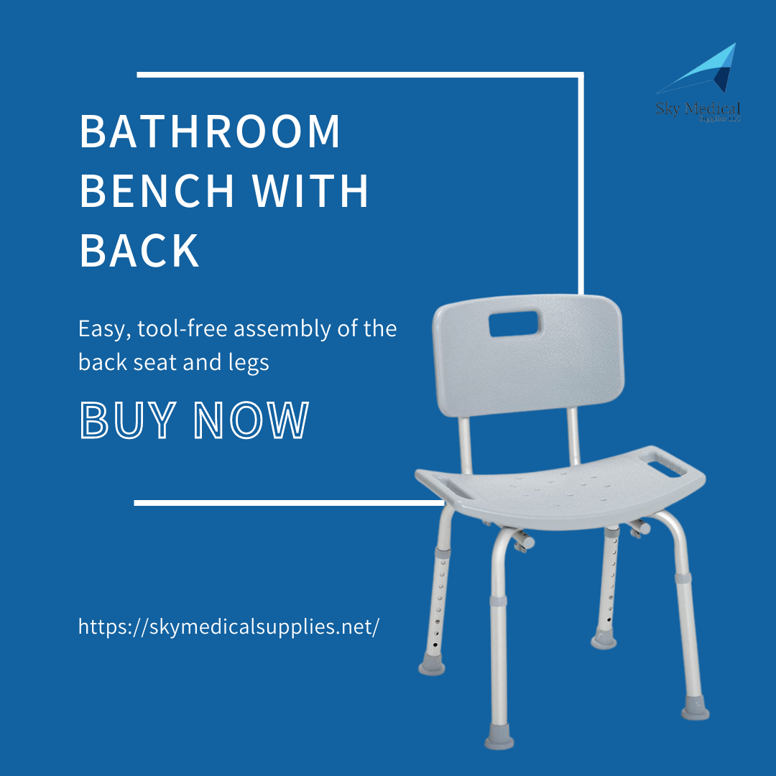
Bath chair features an easy-to-clean plastic seat with a backrest and built-in handles for taking in and out of the bath and shower. This bath chair for seniors and adults has tool-free locking push-button assembly and height adjustments from 13.5" To 20.5" In 1" Increments.
👉 Do you have an interest in our products? visit our store or at 8340 Northfield blvd or our website https://simplyrenting.com/
.
.
.
#skymedical #simplyrenting #medicalsupplies #medicalequipmentsupplies #toptiermedicalsupplies #medicalsuppliesstore #medicalsuppliesretailstore #medical #health #medicallife #staysafe #healthcare #lifestyle #wellness #stayhealthy #healthproblems #healthcareproblems #injury #athlete #wheelchair #wheelchairuser #disability #wheelchairs #spinalcordinjuryrecovery #recovery #powerliftchair #powerscooter #kneewalker #pulseoximeter #oximeter
Feedback here:

Slide 5
The foldable design of the Model F allows it to be easily transported on buses, trains, planes, or in the trunk of a car or taxi. When not in use, the Model F can be conveniently stored in a closet or out-of-the-way corner of the room. The Model F is easy to operate and can make tight turns in narrow indoor spaces.
👉 Do you have an interest in our products? visit our store or at 8340 Northfield blvd or our website https://simplyrenting.com/
.
.
.
#skymedical #simplyrenting #medicalsupplies #medicalequipmentsupplies #toptiermedicalsupplies #medicalsuppliesstore #medicalsuppliesretailstore #medical #health #medicallife #staysafe #healthcare #lifestyle #wellness #stayhealthy #healthproblems #healthcareproblems #injury #athlete #wheelchair #wheelchairuser #disability #wheelchairs #spinalcordinjuryrecovery #recovery #powerliftchair #powerscooter #kneewalker #pulseoximeter #oximeter
Feedback here:

Slide 6
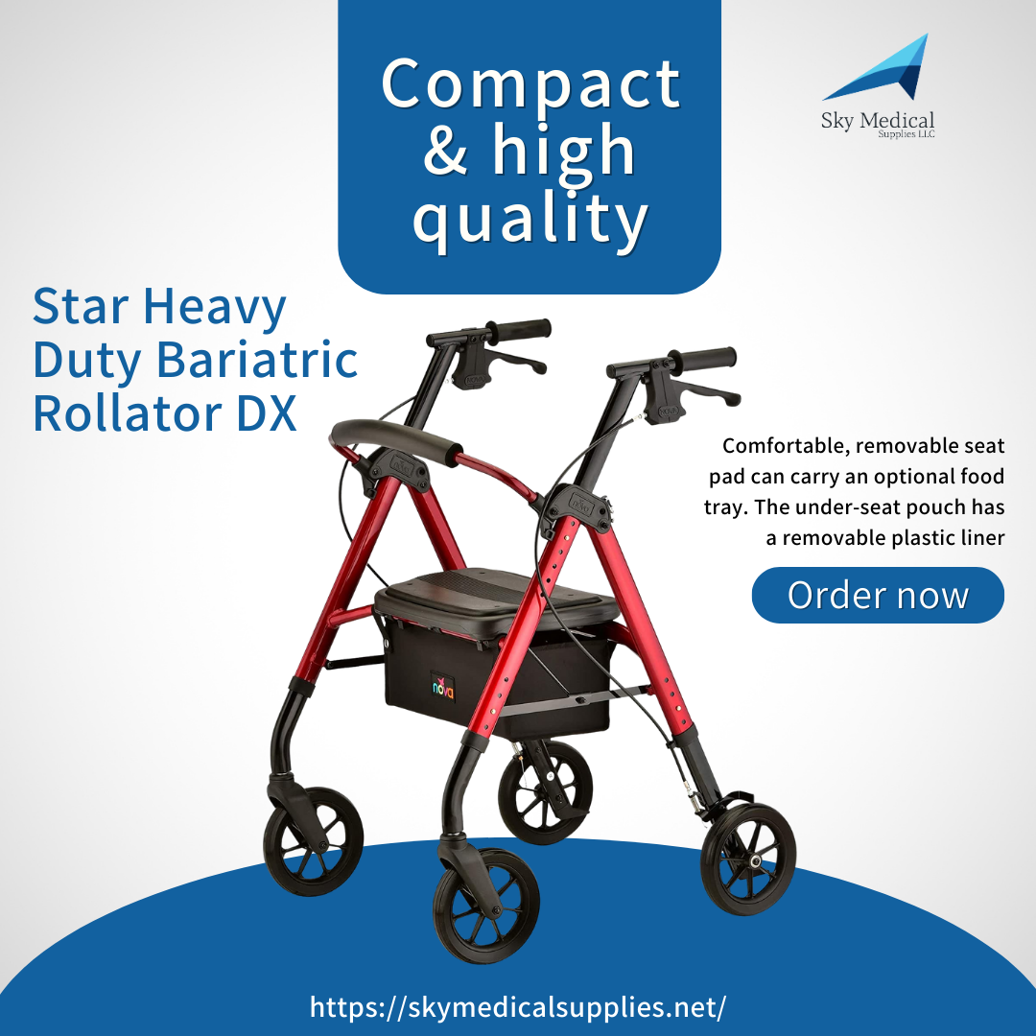
The STAR 8 DX Wide has all of the great STAR DX features we love, including the Lock & Lift folding pin and DX 2-in-1 Seat with removable seat pad that can carry an optional food tray. And now the newest addition to the STAR family has a sleek, wider frame, giving you more comfort and more options!
👉 Do you have an interest in our products? visit our store or at 8340 Northfield blvd or our website https://simplyrenting.com/
.
.
.
#skymedical #simplyrenting #medicalsupplies #medicalequipmentsupplies #toptiermedicalsupplies #medicalsuppliesstore #medicalsuppliesretailstore #medical #health #medicallife #staysafe #healthcare #lifestyle #wellness #stayhealthy #healthproblems #healthcareproblems #injury #athlete #wheelchair #wheelchairuser #disability #wheelchairs #spinalcordinjuryrecovery #recovery #powerliftchair #powerscooter #kneewalker #pulseoximeter #oximeter
Feedback here:

Slide 7
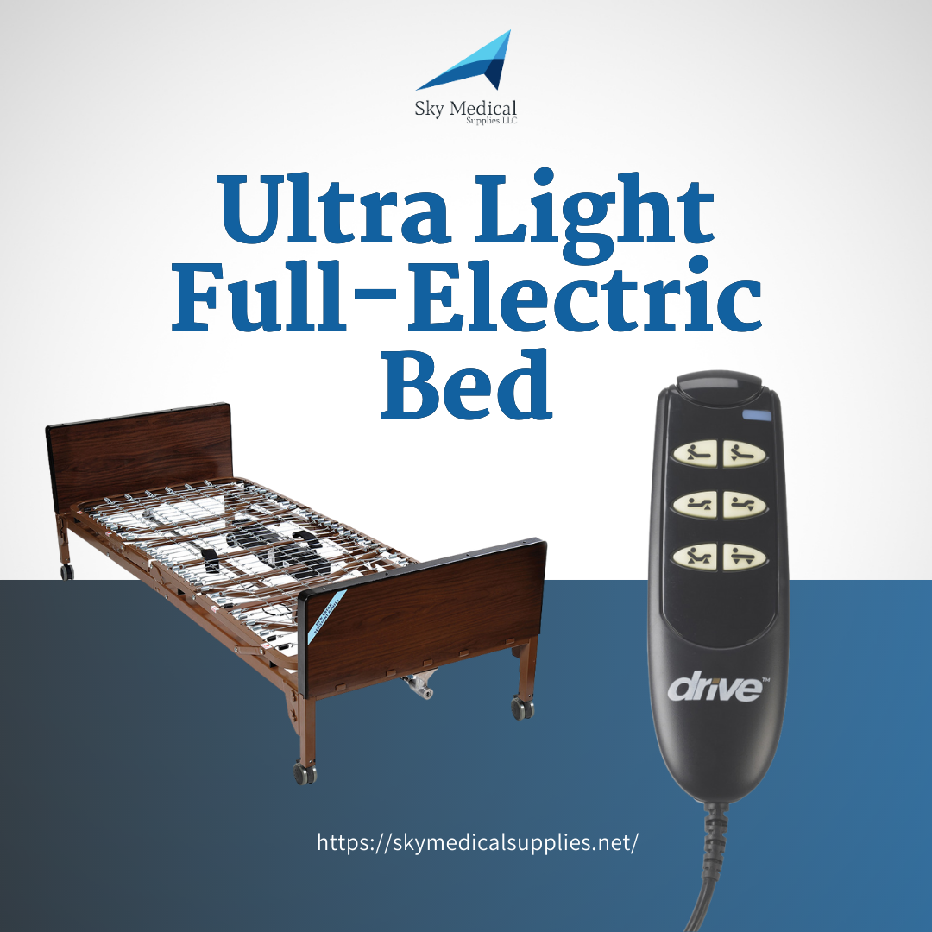
Constructed for strength, this fully-electric bed provides smooth and quiet head, foot, and height positioning.
👉 Do you have an interest in our products? visit our store or at 8340 Northfield blvd or our website https://simplyrenting.com/
.
.
.
#skymedical #simplyrenting #medicalsupplies #medicalequipmentsupplies #toptiermedicalsupplies #medicalsuppliesstore #medicalsuppliesretailstore #medical #health #medicallife #staysafe #healthcare #lifestyle #wellness #stayhealthy #healthproblems #healthcareproblems #injury #athlete #wheelchair #wheelchairuser #disability #wheelchairs #spinalcordinjuryrecovery #recovery #powerliftchair #powerscooter #kneewalker #pulseoximeter #oximeter
Feedback here:

Slide 8
Equipped with All-Terrain 8" rubber wheels with a 1 3/4" wide base, our wheels are durable, great for indoor and outdoor use, and make the ride smooth and stable.
👉 Do you have an interest in our products? visit our store or at 8340 Northfield blvd or our website https://simplyrenting.com/
.
.
.
#skymedical #simplyrenting #medicalsupplies #medicalequipmentsupplies #toptiermedicalsupplies #medicalsuppliesstore #medicalsuppliesretailstore #medical #health #medicallife #staysafe #healthcare #lifestyle #wellness #stayhealthy #healthproblems #healthcareproblems #injury #athlete #wheelchair #wheelchairuser #disability #wheelchairs #spinalcordinjuryrecovery #recovery #powerliftchair #powerscooter #kneewalker #pulseoximeter #oximeter
Feedback here:

Slide 9
The bed offers all the functions and stability of an institutional frame with an easy-to-deliver and assemble package. The split-frame design combines easy, one-person delivery with ultra-low bed height for fall prevention and a full range of options to deliver convenient, effective care in any environment.
👉 Do you have an interest in our products? visit our store or at 8340 Northfield blvd or our website https://simplyrenting.com/
.
.
.
#skymedical #simplyrenting #medicalsupplies #medicalequipmentsupplies #toptiermedicalsupplies #medicalsuppliesstore #medicalsuppliesretailstore #medical #health #medicallife #staysafe #healthcare #lifestyle #wellness #stayhealthy #healthproblems #healthcareproblems #injury #athlete #wheelchair #wheelchairuser #disability #wheelchairs #spinalcordinjuryrecovery #recovery #powerliftchair #powerscooter #kneewalker #pulseoximeter #oximeter
Feedback here:

Slide 10
The GetGO Petite with our signature design and best features. The GetGo comes in 3 sizes - CLASSIC STANDARD (22.25” Seat Height for Users 5’4” - 6’1”), JUNIOR (18.5” Seat Height for Users 4’10” - 5’4”), and PETITE (18.5” Seat Height for users 4’10” - 5’4” in need of more narrow frame and ultra light rollator). The GetGO also comes with a much-needed bonus feature - The Lock n’ Load, which locks the walker in a folded position, making it much easier to lift in and out of a vehicle or any storage situation.
👉 Do you have an interest in our products? visit our store or at 8340 Northfield blvd or our website https://simplyrenting.com/
.
.
.
#skymedical #simplyrenting #medicalsupplies #medicalequipmentsupplies #toptiermedicalsupplies #medicalsuppliesstore #medicalsuppliesretailstore #medical #health #medicallife #staysafe #healthcare #lifestyle #wellness #stayhealthy #healthproblems #healthcareproblems #injury #athlete #wheelchair #wheelchairuser #disability #wheelchairs #spinalcordinjuryrecovery #recovery #powerliftchair #powerscooter #kneewalker #pulseoximeter #oximeter
Feedback here:

Slide 11
Easy to install without tools; sturdy clip-on brackets fit most standard walkers. Carry food, drinks, or personal items while on the move.Conveniently folds down when not in use.
👉 Do you have an interest in our products? visit our store or at 8340 Northfield blvd or our website https://simplyrenting.com/
.
.
.
#skymedical #simplyrenting #medicalsupplies #medicalequipmentsupplies #toptiermedicalsupplies #medicalsuppliesstore #medicalsuppliesretailstore #medical #health #medicallife #staysafe #healthcare #lifestyle #wellness #stayhealthy #healthproblems #healthcareproblems #injury #athlete #wheelchair #wheelchairuser #disability #wheelchairs #spinalcordinjuryrecovery #recovery #powerliftchair #powerscooter #kneewalker #pulseoximeter #oximeter
Feedback here:

Slide 12
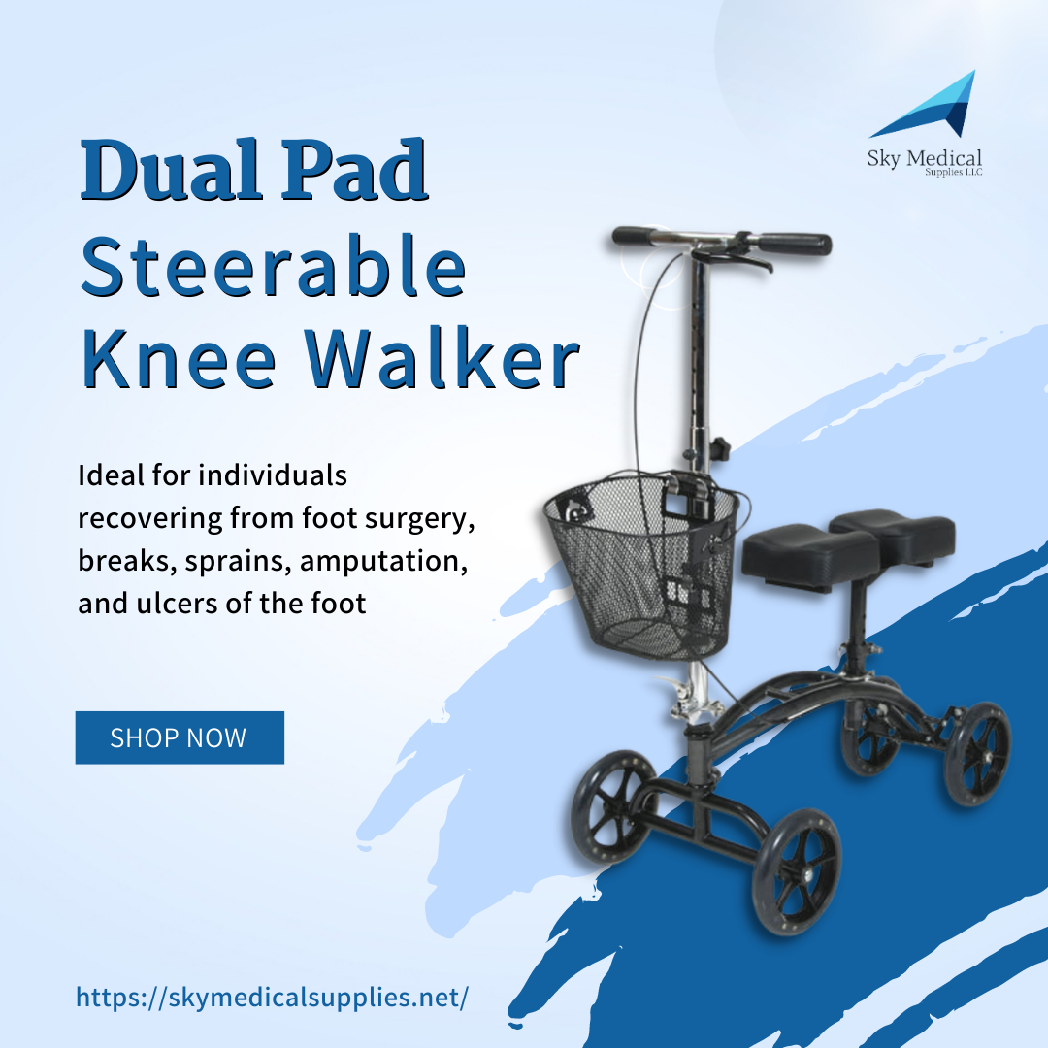
If you are experiencing pain or discomfort following foot surgery, breaks, sprains, or ulcers, the dual pad steerable knee walker with a basket from the drive is a simple, comfortable, durable, and pain-free crutch alternative.
👉 Do you have an interest in our products? visit our store or at 8340 Northfield blvd or our website https://simplyrenting.com/
.
.
.
#skymedical #simplyrenting #medicalsupplies #medicalequipmentsupplies #toptiermedicalsupplies #medicalsuppliesstore #medicalsuppliesretailstore #medical #health #medicallife #staysafe #healthcare #lifestyle #wellness #stayhealthy #healthproblems #healthcareproblems #injury #athlete #wheelchair #wheelchairuser #disability #wheelchairs #spinalcordinjuryrecovery #recovery #powerliftchair #powerscooter #kneewalker #pulseoximeter #oximeter
Feedback here:

Slide 13
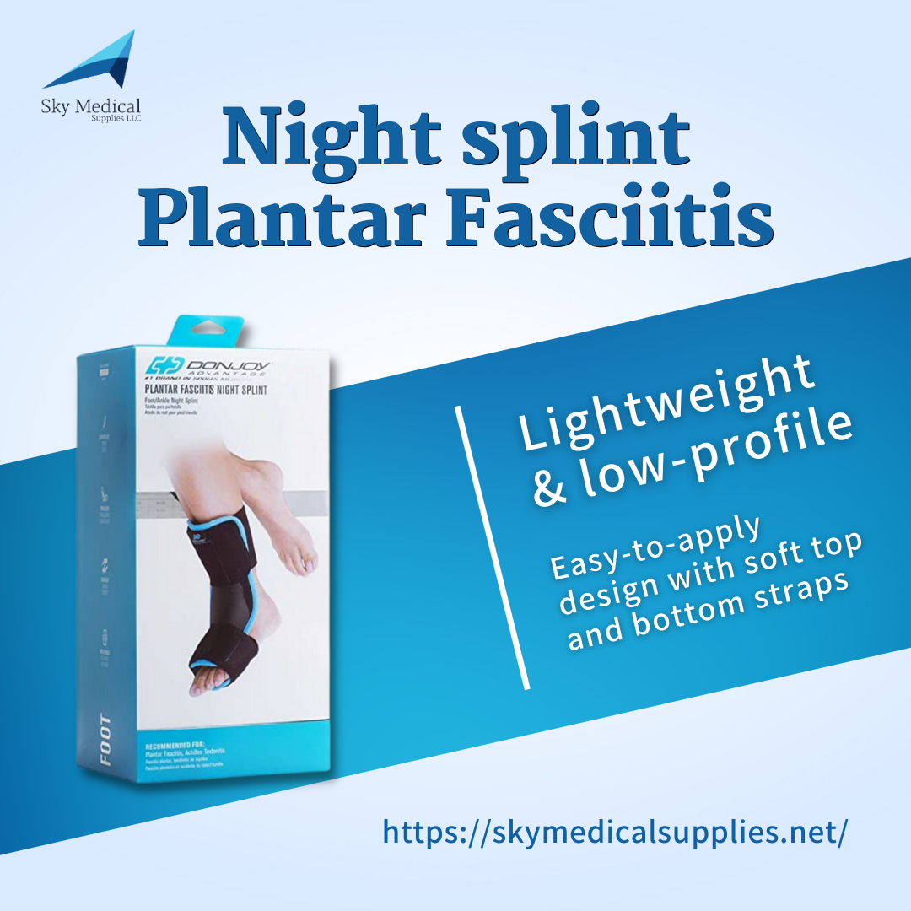
The Advantage Plantar Fasciitis Night Splint helps ease foot pain associated with Plantar Fasciitis and Achilles Tendonitis. Designed as a low-profile, lightweight night splint, this splint keeps the foot in a 90-degree position all night, providing a nice stretch to help relieve foot aches.
👉 Do you have an interest in our products? visit our store or at 8340 Northfield blvd or our website https://simplyrenting.com/
.
.
.
#skymedical #simplyrenting #medicalsupplies #medicalequipmentsupplies #toptiermedicalsupplies #medicalsuppliesstore #medicalsuppliesretailstore #medical #health #medicallife #staysafe #healthcare #lifestyle #wellness #stayhealthy #healthproblems #healthcareproblems #injury #athlete #wheelchair #wheelchairuser #disability #wheelchairs #spinalcordinjuryrecovery #recovery #powerliftchair #powerscooter #kneewalker #pulseoximeter #oximeter
Feedback here:

Slide 14
Readily accessible patient controls, protected cannula fitting, and recessed humidifier nook to prevent damage. Alarms Audible and visual high/low pressure, low flow, low oxygen, power fail, Oxygen Sensing Device.
👉 Do you have an interest in our products? visit our store or at 8340 Northfield blvd or our website https://simplyrenting.com/
.
.
.
#skymedical #simplyrenting #medicalsupplies #medicalequipmentsupplies #toptiermedicalsupplies #medicalsuppliesstore #medicalsuppliesretailstore #medical #health #medicallife #staysafe #healthcare #lifestyle #wellness #stayhealthy #healthproblems #healthcareproblems #injury #athlete #wheelchair #wheelchairuser #disability #wheelchairs #spinalcordinjuryrecovery #recovery #powerliftchair #powerscooter #kneewalker #pulseoximeter #oximeter
Feedback here:

