Slide 1
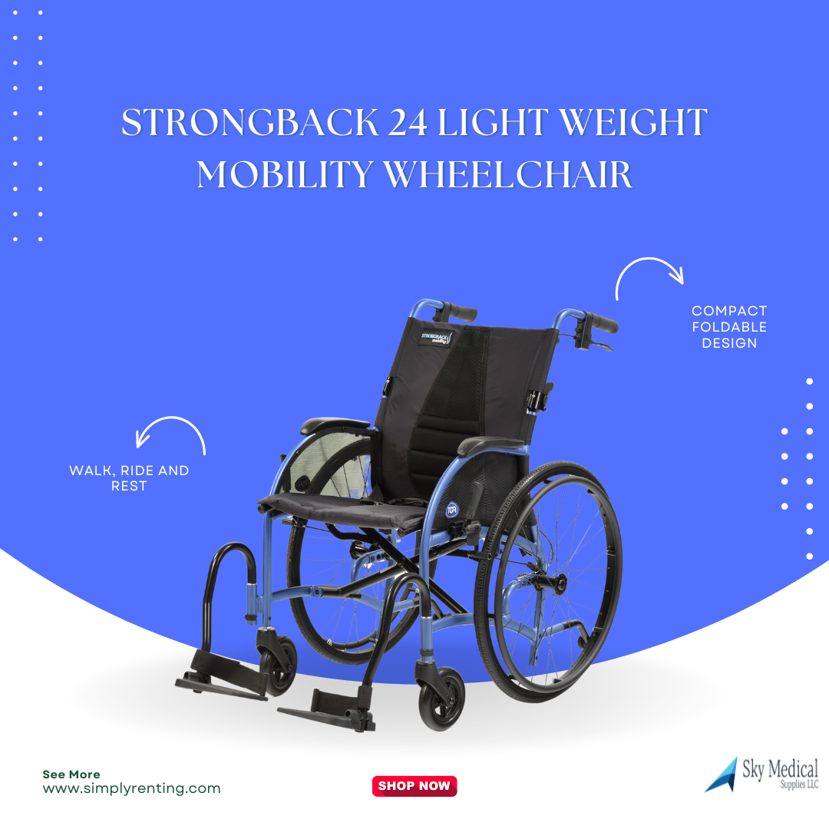
STRONGBACK 24 lightweight mobility wheelchair
Product Features and Benefits -
Features Patented STRONGBACK ergonomics with easily adjustable posture support in the backrest Compact foldable design Ultra-lightweight Swing-away detachable footrests Ergonomic comfort-grip handles Comfortable desktop-length armrests Weight capacity: 300 lbs.
Specifications STRONGBACK 24, Medium - 18" seat Quick-release wheels three-position rear axle for beginner, intermediate, and expert users 24-inch rear wheels Size
(unfolded): 40X27X37 inches Size (folded): 29X14X29.5 inches Net Weight: 13.8 lbs. (without footrests, wheels, and anti-tippers) Total Weight: 25.8 lbs.
STRONGBACK 24, Large - 20" seat Quick-release wheels three-position rear axle for beginner, intermediate, and expert users 24 inch rear wheels Size (unfolded): 40X29X37 inches Size (folded): 29X14X32 inches Net Weight: 13.8 lbs. (without footrests, wheels, and anti-tippers) Total Weight: 25.8 lbs.
If are interested in our products make sure to visit our store or
Our website- www.simplyrenting.com
Product Link- STRONGBACK 24 light weight mobility wheelchair | sky medical supplies llc (live-skymedical.pantheonsite.io)
#skymedical #simplyrenting #medicalsupplies #medical #covid #healthcare #medicalequipment #medical #healthcare #lifestyle #medicaldoctor #health #Healthcare #healthcarecenters #hospitalequipment #athlete #wheelchair #wheelchairuser #disability #wheelchairs #spinalcordinjuryrecovery #recovery #powerliftchair #powerscooter #kneewalker #pulseoximeter #oximeter #scooterrental #hospitalbed #mobilityscooter
Feedback here:

Slide 2
So Lite Wheelchair Journey Health & lifesyle
Product Features and Benefits -
When choosing a wheelchair, it’s good to weigh your options . . . Introducing the So Lite™ Wheelchair—just 16.5 pounds
Ever since their invention in the 17th century, self-propelled wheelchairs have remained too heavy, too clunky, awkward in tight spaces, not very comfortable and hard to transport—but they were and are priceless mobility to those who need them.
That’s why the introduction of the uniquely designed So Lite™ Wheelchair is truly significant—ok, revolutionary! This chair addresses all the problems long associated with wheelchair design and weight while making self-propelled mobility safer, more comfortable, convenient, and attainable. First, it’s super lightweight—the frame weighs 16½ pounds with the quick-release back wheels removed.
If are interested in our products make sure to visit our store or
Our website- www.simplyrenting.com
Product Link- https://live-skymedical.pantheonsite.io/en/product/so-lite-ultra-light-weight-wheelchair
#skymedical #simplyrenting #medicalsupplies #medical #covid #healthcare #medicalequipment #medical #healthcare #lifestyle #medicaldoctor #health #Healthcare #healthcarecenters #hospitalequipment #athlete #wheelchair #wheelchairuser #disability #wheelchairs #spinalcordinjuryrecovery #recovery #powerliftchair #powerscooter #kneewalker #pulseoximeter #oximeter #scooterrental #hospitalbed #mobilityscooter
Feedback here:

Slide 3
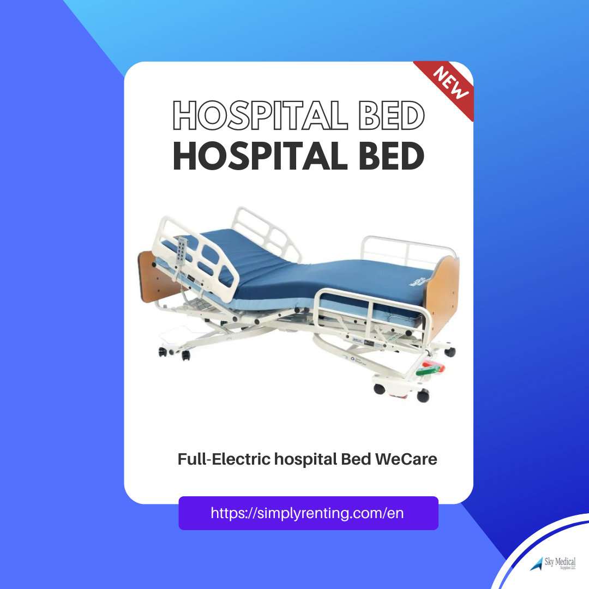
Full-Electric hospital Bed WeCare
Product Features and Benefits -
The Joerns WeCare™ bed offers all the functions and stability of an institutional frame with an easy-to-deliver and assemble package. The split-frame design combines easy, one-person delivery with ultra-low bed height for fall prevention and a full range of options to deliver convenient, effective care in any environment.
If are interested in our products make sure to visit our store or
Our website- www.simplyrenting.com
Product Link- https://live-skymedical.pantheonsite.io/en/product/full-electric-hospital-bed-wecare?v=1369
#skymedical #simplyrenting #medicalsupplies #medical #covid #healthcare #medicalequipment #medical #healthcare #lifestyle #medicaldoctor #health #Healthcare #healthcarecenters #hospitalequipment #athlete #wheelchair #wheelchairuser #disability #wheelchairs #spinalcordinjuryrecovery #recovery #powerliftchair #powerscooter #kneewalker #pulseoximeter #oximeter #scooterrental #hospitalbed #mobilityscooter
Feedback here:

Slide 4
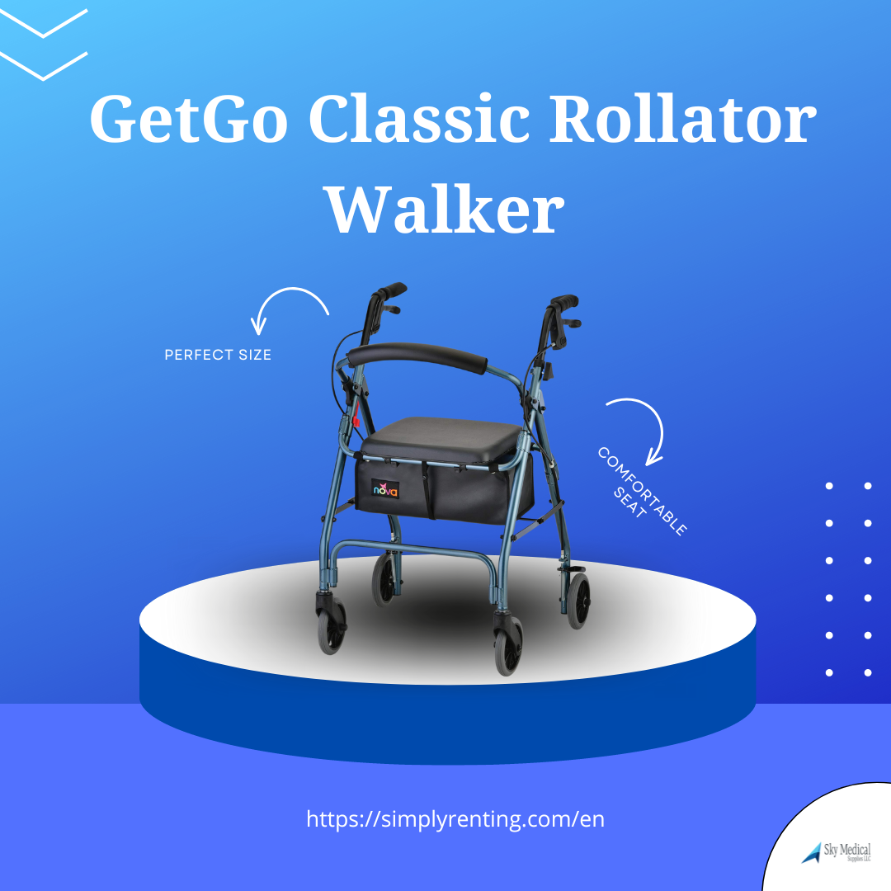
GetGo Classic Rollator Walker Standard Size
Product Features and Benefits -
NOVA GetGo Classic Rollator Walker (Standard Size), Rolling Walker for Height 5'4" - 6'1", Seat Height is 22.25 Inch,
CHOOSE YOUR PERFECT SIZE - CLASSIC STANDARD, JUNIOR & PETITE: The GetGO Classic is a true NOVA classic with our signature design and best features. The GetGo comes in 3 sizes - CLASSIC STANDARD (22.25” Seat Height for Users 5’4” - 6’1”), JUNIOR (18.5” Seat Height for Users 4’10” - 5’4”), and PETITE (18.5” Seat Height for users 4’10” - 5’4” in need of more narrow frame and ultra light rollator). The GetGO also comes with a much-needed bonus feature - The Lock n’ Load, which locks the walker in a folded position, making it much easier to lift in and out of a vehicle or any storage situation.
WHEELS & BRAKES: Equipped with 6" rubber wheels with a 1" wide base, NOVA's wheels are durable, great for indoor and outdoor use and make the ride smooth and stable. NOVA's patented feather touch hand brakes are uniquely designed for maximum comfort and control. It is easy to engage the brake with a small grip and minimal hand strength. Parking or locking the brakes takes just a gentle push down on the lever and a pull upwards to release. Our brakes are backed by the best Brake Warranty with a 5-year warranty on all brake parts
SEAT & STORAGE: The 2” thick padded seat is comfortable, durable, and easy to clean. Seat Dimensions: 13.75"W x 12.75"D. The roomy pouch is great to store and carry personal items - and keeping them secure and out of sight. There is also a small pocket inside the pouch for keys and phones. Pouch Dimensions: 15.5"W x 9.25"D x 6.25”H
If are interested in our products make sure to visit our store or
Our website- www.simplyrenting.com
Product Link-https://live-skymedical.pantheonsite.io/en/product/getgo-classic-rollator-walker-standard-size?v=1361
#skymedical #simplyrenting #medicalsupplies #medical #covid #healthcare #medicalequipment #medical #healthcare #lifestyle #medicaldoctor #health #Healthcare #healthcarecenters #hospitalequipment #athlete #wheelchair #wheelchairuser #disability #wheelchairs #spinalcordinjuryrecovery #recovery #powerliftchair #powerscooter #kneewalker #pulseoximeter #oximeter #scooterrental #hospitalbed #mobilityscooter
Feedback here:

Slide 5
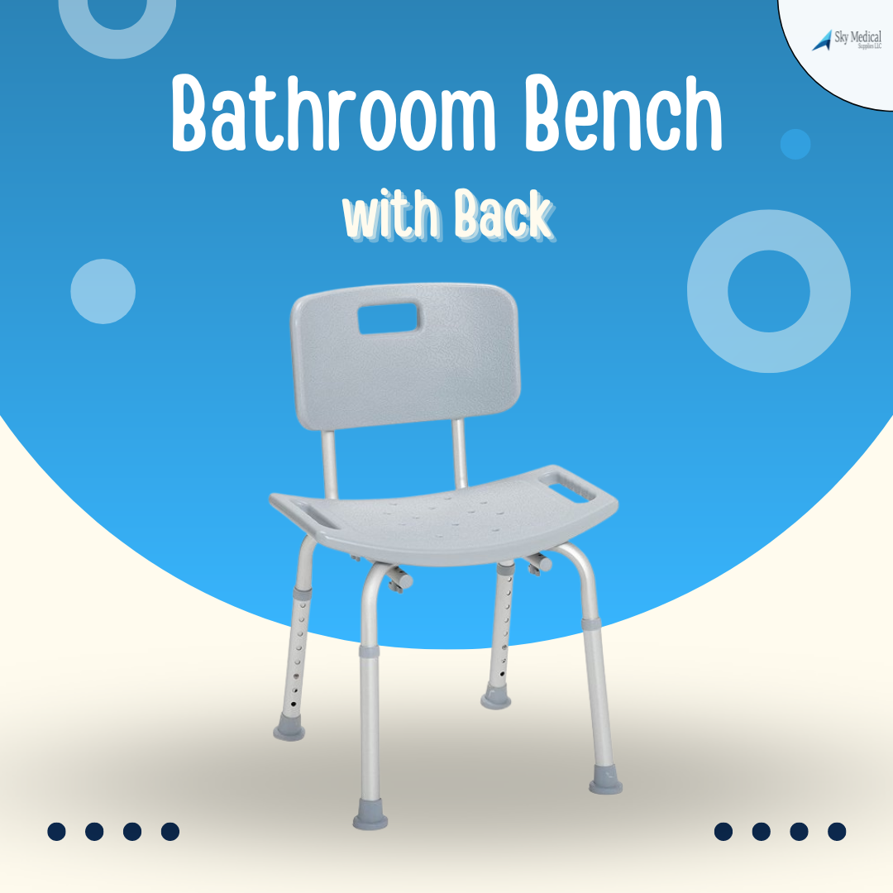
Bathroom Bench with Back
Product Features and Benefits -
Bathroom Bench: Designed to fit just about any style of bathtub, our tub bench for the bathroom is exceptionally easy to assemble without tools
Quality Construction: The ultimate shower accessory for daily living, our tub chair for elderly, disabled, and injured individuals is made of durable aluminum and features a comfortable 19.25-inch seat
Height Adjustable: Designed to fit your unique needs, our adjustable stool has legs that can be adjusted in 1-inch increments
Secure and Scratchproof: Our bath seat for bathtubs and showers comes equipped with suction-style tips on the legs, providing stability and drainage holes that reduce slipping
Dimensions: Width: 19.25 Inches x Length: 11.5 Inches; Product Height: 28 Inch (With Back), 19.5 Inch (Without Back); Seat Height: 15.5 Inch - 19.5 Inch; Weight capacity: 300 pounds
If are interested in our products make sure to visit our store or
Our website- www.simplyrenting.com
Product Link- https://live-skymedical.pantheonsite.io/en/product/bathroom-bench-back
..#skymedical #simplyrenting #medicalsupplies #medical #covid #healthcare #medicalequipment #medical #healthcare #lifestyle #medicaldoctor #health #Healthcare #healthcarecenters #hospitalequipment #athlete #wheelchair #wheelchairuser #disability #wheelchairs #spinalcordinjuryrecovery #recovery #powerliftchair #powerscooter #kneewalker #pulseoximeter #oximeter #scooterrental #hospitalbed #mobilityscooter
Feedback here:

Slide 6
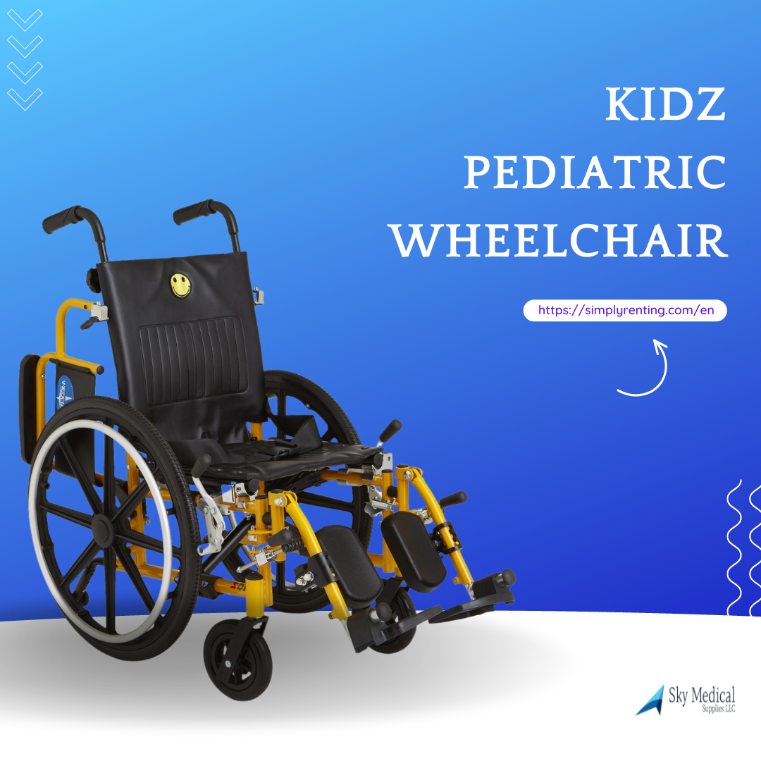
Kidz Pediatric Wheelchair
Product Features and Benefits -
DJUSTABLE COMPRESSION THERAPY
Adjustable telescoping handles for caregiver comfort.
Durable vinyl upholstery.
Treaded, flat-free tires for safe riding.
Anti-tippers included.
Standard dual axle allows for easy adjustment of seat height to hemi level.
Armrests and calf pads are upholstered and padded.
Flip-back arms.
Arm style: swing back desk length permanent; Leg style: detachable elevating legrests.
Seat size 14" x 12" (36 cm x 30 cm).
300 lb. weight capacity
SKU: KPD2N22S 12" Wide Kidz Pediatric Wheelchair
If are interested in our products make sure to visit our store or
Our website- www.simplyrenting.com
Product Link- https://simplyrenting.com/en/product/kidz-pediatric-wheelchair-k?v=1230
.#skymedical #simplyrenting #medicalsupplies #medical #covid #healthcare #medicalequipment #medical #healthcare #lifestyle #medicaldoctor #health #Healthcare #healthcarecenters #hospitalequipment #athlete #wheelchair #wheelchairuser #disability #wheelchairs #spinalcordinjuryrecovery #recovery #powerliftchair #powerscooter #kneewalker #pulseoximeter #oximeter #scooterrental #hospitalbed #mobilityscooter
Feedback here:

Slide 7
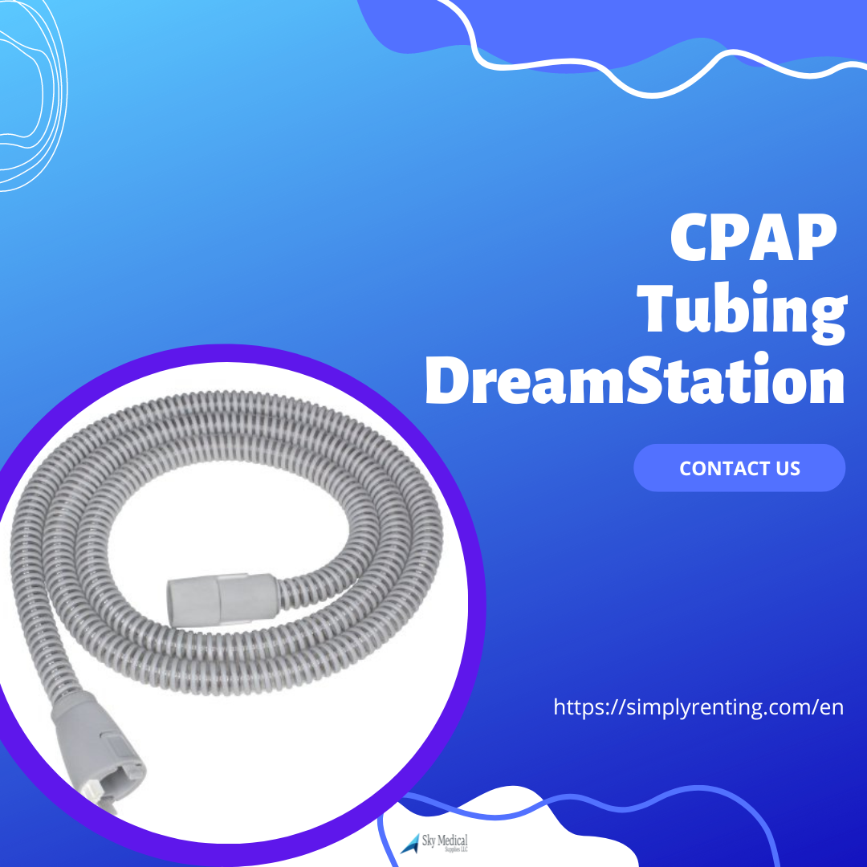
CPAP Tubing DreamStation
Product Features and Benefits -
CPAP Tubing DreamStation 6 Foot Length Tubing heated nonheated
The 15 mm Heated Slim Tube is the replacement for all Respironics DreamStation CPAP, APAP, and BiPAP machines with Heated Humidifier
Air temperature in the tube can be set between 0 and 5 when connected to the humidifier.
No heat will produce on 0 heat setting.
This Respironics Heated Tubing delivers desired air temperature while you sleep
Even though it is 15 mm Connector it will attach to any 22 mm CPAP machines
If are interested in our products make sure to visit our store or
Our website- www.simplyrenting.com
Product Link-https://simplyrenting.com/en/product/cpap-tubing-dreamstation?v=1209
#skymedical #simplyrenting #medicalsupplies #medical #covid #healthcare #medicalequipment #medical #healthcare #lifestyle #medicaldoctor #health #Healthcare #healthcarecenters #hospitalequipment #athlete #wheelchair #wheelchairuser #disability #wheelchairs #spinalcordinjuryrecovery #recovery #powerliftchair #powerscooter #kneewalker #pulseoximeter #oximeter #scooterrental #hospitalbed #mobilityscooter
Feedback here:

Slide 8
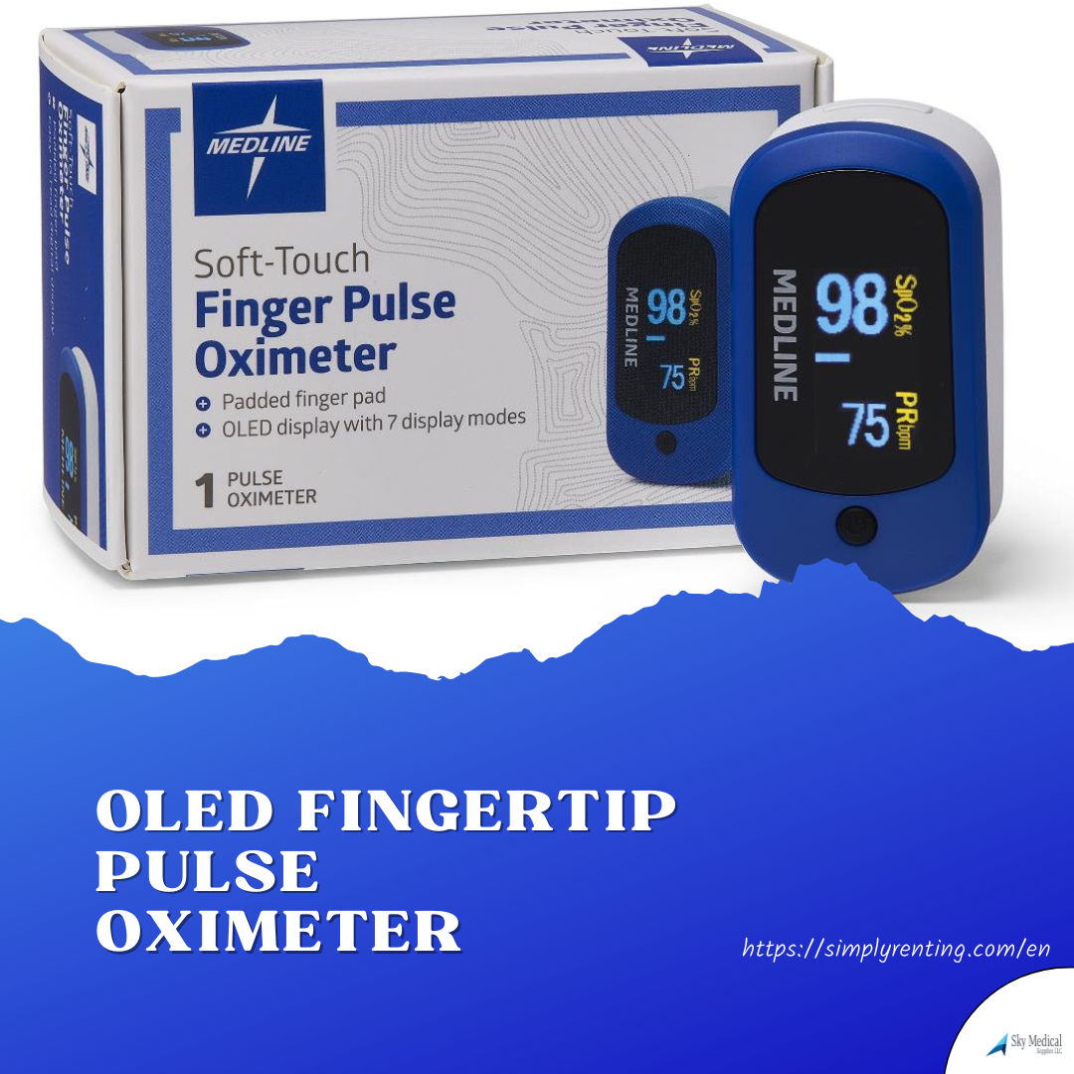
OLED Fingertip Pulse Oximeter
Product Features and Benefits -
OLED Fingertip Pulse Oximeter
Small, lightweight finger clip with a bright OLED display and 7 viewing directions designed to quickly read SpO2 and patient heart rate
Complete with lanyard, instructions, and 2 AAA batteries with 24-hour continuous use
Prescription required to purchase
FDA cleared for medical use
If are interested in our products make sure to visit our store or
Our website- www.simplyrenting.com
Product Link- https://simplyrenting.com/en/product/pulse-oximeter-fingertip?v=1139
.#skymedical #simplyrenting #medicalsupplies #medical #covid #healthcare #medicalequipment #medical #healthcare #lifestyle #medicaldoctor #health #Healthcare #healthcarecenters #hospitalequipment #athlete #wheelchair #wheelchairuser #disability #wheelchairs #spinalcordinjuryrecovery #recovery #powerliftchair #powerscooter #kneewalker #pulseoximeter #oximeter #scooterrental #hospitalbed #mobilityscooter
Feedback here:

Slide 9
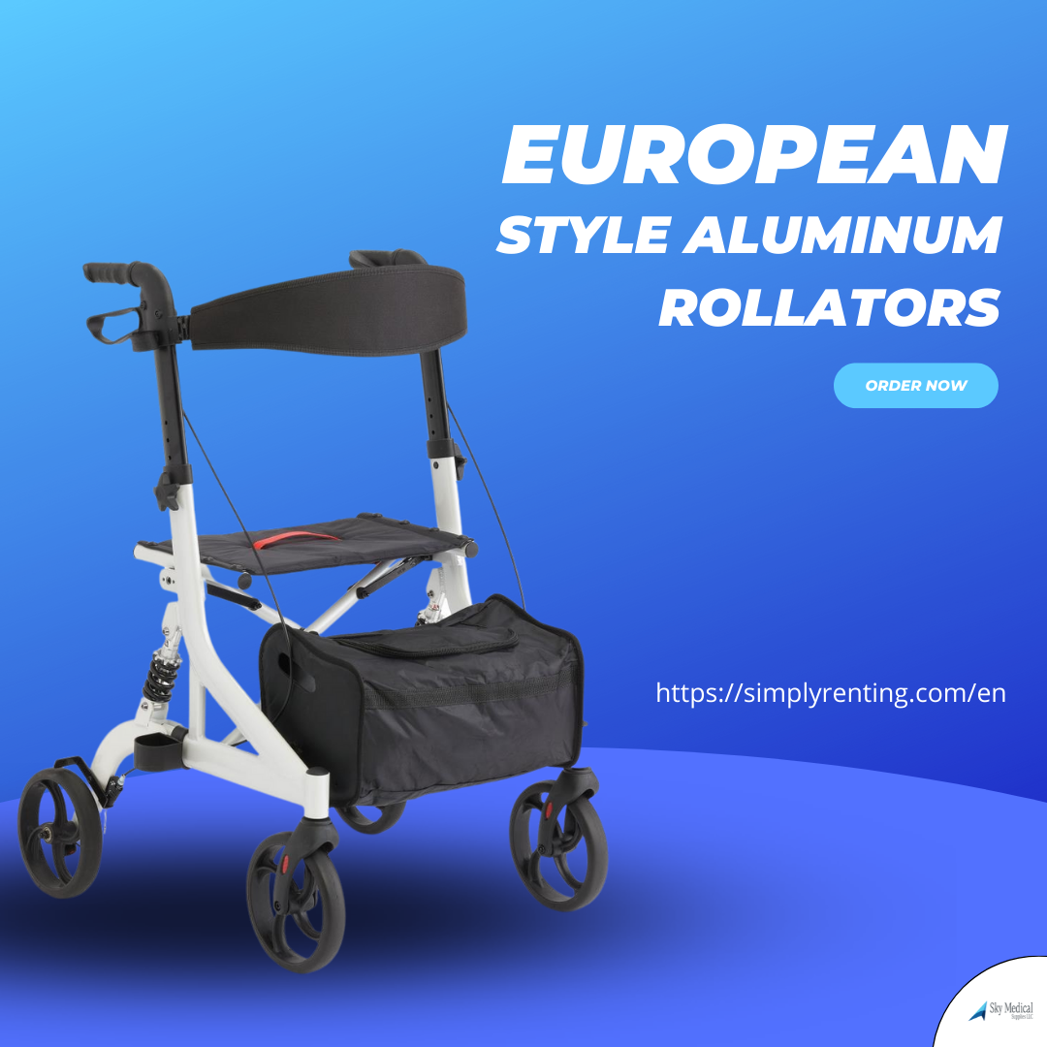
European-Style Aluminum Rollators
Product Features and Benefits -
European-style rollators feature a lightweight aluminum frame
Fold horizontally for easy storage
300 lb. weight capacity
Storage bag included
Guardian rollator
European-style rollators feature a lightweight aluminum frame
Fold horizontally for easy storage
300 lb. weight capacity
Storage bag included
Travel in style with the sleek design of the Euro-style
If are interested in our products make sure to visit our store or
Our website- www.simplyrenting.com
Product Link- https://simplyrenting.com/en/product/euro-style-rolling-walker?v=1236
#skymedical #simplyrenting #medicalsupplies #medical #covid #healthcare #medicalequipment #medical #healthcare #lifestyle #medicaldoctor #health #Healthcare #healthcarecenters #hospitalequipment #athlete #wheelchair #wheelchairuser #disability #wheelchairs #spinalcordinjuryrecovery #recovery #powerliftchair #powerscooter #kneewalker #pulseoximeter #oximeter #scooterrental #hospitalbed #mobilityscooter
Feedback here:

Slide 10
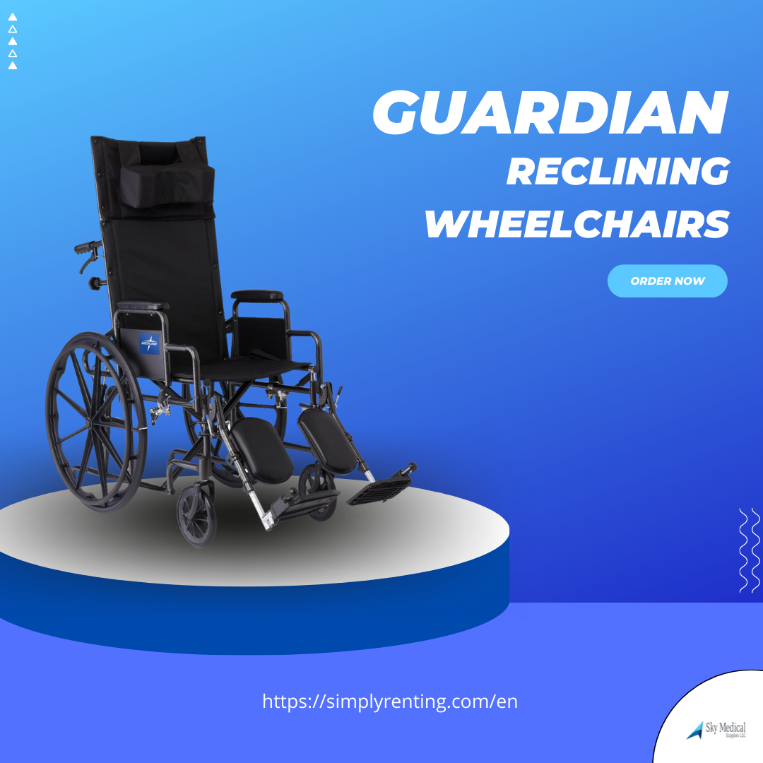
Guardian Reclining Wheelchairs
Product Features and Benefits -
Reclining wheelchair with desk-length arms and elevating leg rests
Nylon construction for easy cleaning
300 lb. weight capacity
If are interested in our products make sure to visit our store or
Our website- www.simplyrenting.com
Product Link- https://simplyrenting.com/en/product/wheelchairs-recliner?v=1237
.#skymedical #simplyrenting #medicalsupplies #medical #covid #healthcare #medicalequipment #medical #healthcare #lifestyle #medicaldoctor #health #Healthcare #healthcarecenters #hospitalequipment #athlete #wheelchair #wheelchairuser #disability #wheelchairs #spinalcordinjuryrecovery #recovery #powerliftchair #powerscooter #kneewalker #pulseoximeter #oximeter #scooterrental #hospitalbed #mobilityscooter
Feedback here:

Slide 11
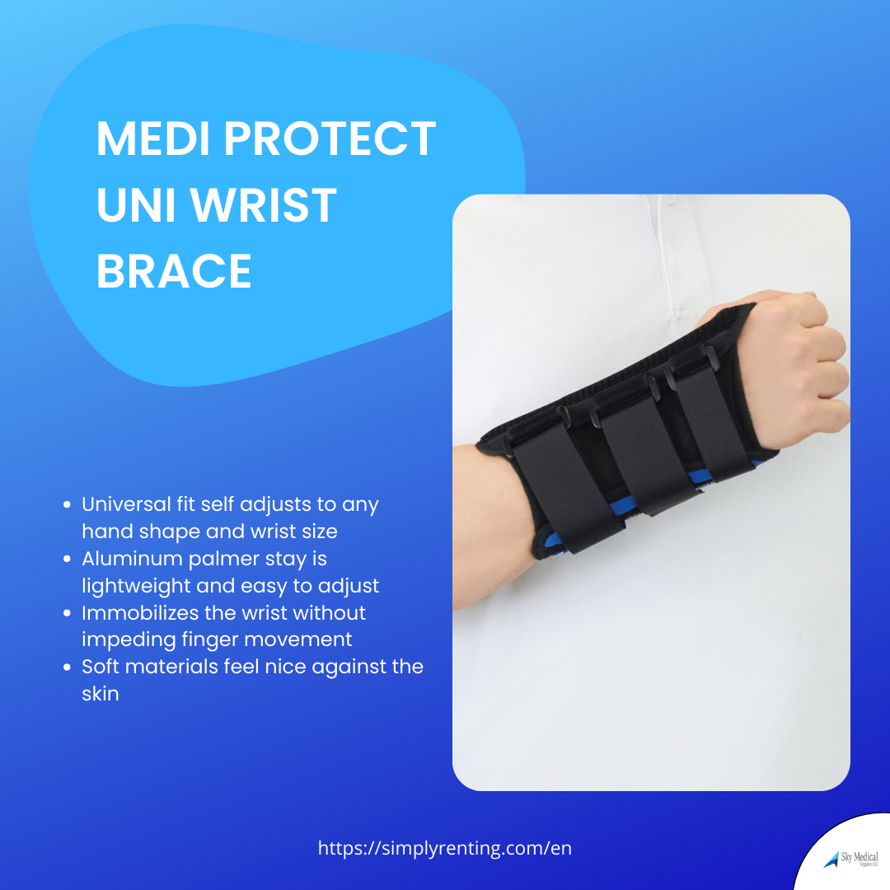
MEDI PROTECT UNI WRIST BRACE
Product Features and Benefits -
Universal fit self adjusts to any hand shape and wrist size
Aluminium palmer stay is lightweight and easy to adjust
Immobilizes the wrist without impeding finger movement
Soft materials feel nice against the skin
If are interested in our products make sure to visit our store or
Our website- www.simplyrenting.com
Product Link- https://simplyrenting.com/en/product/medi-protect-uni-wrist-brace-lt-blablu?v=1098
.#skymedical #simplyrenting #medicalsupplies #medical #covid #healthcare #medicalequipment #medical #healthcare #lifestyle #medicaldoctor #health #Healthcare #healthcarecenters #hospitalequipment #athlete #wheelchair #wheelchairuser #disability #wheelchairs #spinalcordinjuryrecovery #recovery #powerliftchair #powerscooter #kneewalker #pulseoximeter #oximeter #scooterrental #hospitalbed #mobilityscooter
Feedback here:

Slide 12
Saline Wound Wash
Features and Benefits -
Saline Wound Wash Medline Curad 7.1-oz. Sterile Spray
CURAD Saline Wound Wash gently cleanses minor cuts, scrapes and burns
Pressurized flow effectively removes dirt and debris with better control and less waste
It dispenses a controlled spray at any angle, even upside down
Sterile, 0.9% USP sodium chloride
If are interested in our products make sure to visit our store or
Our website- www.simplyrenting.com
Product Link- https://simplyrenting.com/en/product/saline-wound-wash?v=1154
#skymedical #simplyrenting #medicalsupplies #medical #covid #healthcare #medicalequipment #medical #healthcare #lifestyle #medicaldoctor #health #Healthcare #healthcarecenters #hospitalequipment #athlete #wheelchair #wheelchairuser #disability #wheelchairs #spinalcordinjuryrecovery #recovery #powerliftchair #powerscooter #kneewalker #pulseoximeter #oximeter #scooterrental #hospitalbed #mobilityscooter
Feedback here:

Slide 13
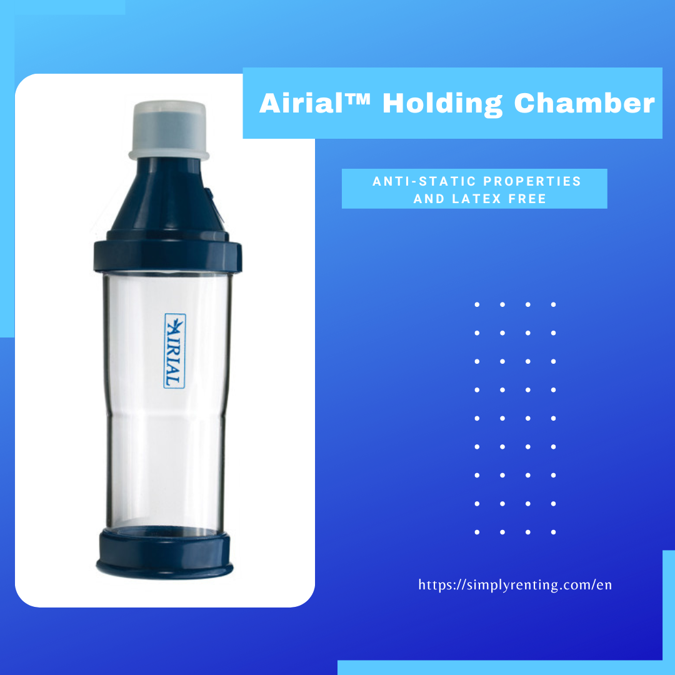
Airial™ Holding Chamber
Product Features and Benefits -
DJUSTABLE COMPRESSION THERAPY
The Drive Medical Aerial Holding Chamber is an aerosol medication aid. Aersol medications primarily target the lungs and trachea to avoid the side effects of oral medications. However, these medications can be difficult to take effect. When using a gaseous medication, you can't see it, and you may not know if you're taking it effectively. This device helps by allowing a sealed chamber to be filled with medication until the patient is ready to inhale. This product works with most CFC and HFA meter dose inhalers, connecting to a seal at the end. An Aerial Chamber (Drive Medical MQ8000) can help reduce medication waste and maximize medication delivery. Also, a Drive Medical Aerial Aerosol Medication Chamber is easy to use and maintain. It's made from anti-static materials and is latex-free. This device can be used as-is or with a nebulizer mask such as the AERIAL Spotz the Dog Mask with Meter Dose Inhaler Chamber for children who may have difficulty using aerosol medication on their own.
If are interested in our products make sure to visit our store or
Our website- www.simplyrenting.com
Product Link- https://simplyrenting.com/en/product/groin-brace-adjustable-compression-wrap?v=1318..
#skymedical #simplyrenting #medicalsupplies #medical #covid #healthcare #medicalequipment #medical #healthcare #lifestyle #medicaldoctor #health #Healthcare #healthcarecenters #hospitalequipment #athlete #wheelchair #wheelchairuser #disability #wheelchairs #spinalcordinjuryrecovery #recovery #powerliftchair #powerscooter #kneewalker #pulseoximeter #oximeter #scooterrental #hospitalbed #mobilityscooter
Feedback here:

Slide 14
Night splint Plantar Fasciitis
Product Features and Benefits -
the DonJoy Advantage Plantar Fasciitis Night Splint helps ease foot pain associated with Plantar Fasciitis and Achilles Tendonitis. Designed as a low-profile, lightweight night splint, this splint keeps the foot in a 90-degree position all night, providing a nice stretch to help relieve foot aches. The rigid shell has foam padding for additional comfort and two straps to hold the splint in place. The Plantar Fasciitis Night Splint is easy to put on and adjust and can be worn on the left or right foot. Note: This brace is not load-bearing. It is to be worn during sleep.
If are interested in our products make sure to visit our store or
Our website- www.simplyrenting.com
Product Link- https://simplyrenting.com/en/product/groin-brace-adjustable-compression-wrap?v=1318..
#skymedical #simplyrenting #medicalsupplies #medical #covid #healthcare #medicalequipment #medical #healthcare #lifestyle #medicaldoctor #health #Healthcare #healthcarecenters #hospitalequipment #athlete #wheelchair #wheelchairuser #disability #wheelchairs #spinalcordinjuryrecovery #recovery #powerliftchair #powerscooter #kneewalker #pulseoximeter #oximeter #scooterrental #hospitalbed #mobilityscooter
Feedback here:

Slide 15
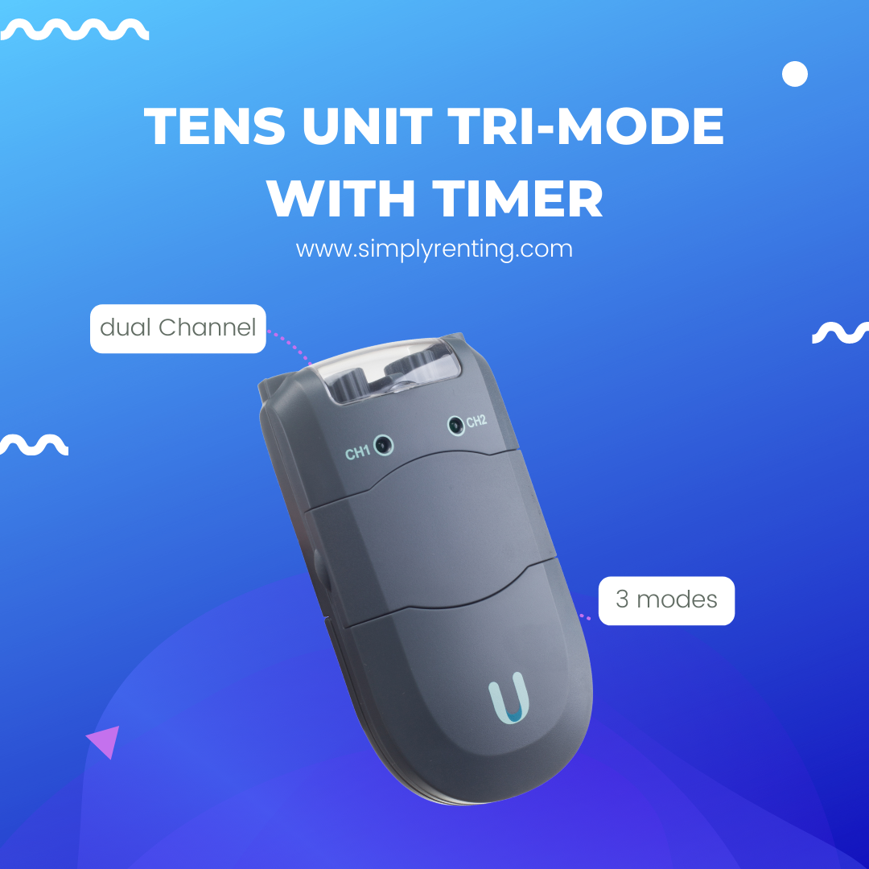
TENS unit tri-mode with timer
Product Features and Benefits -
The electrical nerve stimulation device is applied to the skin's surface at the site of the pain. Remove the sleek black neuromuscular stimulator unit from its professional case, insert the battery, apply the electrodes, and plug in the lead wires. Turn on the muscular stimulator unit which has three modes(Burst, Normal, and Modulation), to adjust the pulse width (how strong the current is) and the frequency (how many times the current is delivered over time), and you can enjoy a pain-free day while you take it anywhere you go. TENS neuromuscular therapy stimulates sensory nerves to block pain signals, stimulates endorphin production to help normalize sympathetic function, and has a biphasic, low-volt current. The neuromuscular stimulator comes with a 5-year warranty against mechanical defects.
If are interested in our products make sure to visit our store or
Our website- www.simplyrenting.com
Product Link- https://simplyrenting.com/en/product/tens-unit-tri-mode-timer?v=1035
#skymedical #simplyrenting #medicalsupplies #medical #covid #healthcare #medicalequipment #medical #healthcare #lifestyle #medicaldoctor #health #Healthcare #healthcarecenters #hospitalequipment #athlete #wheelchair #wheelchairuser #disability #wheelchairs #spinalcordinjuryrecovery #recovery #powerliftchair #powerscooter #kneewalker #pulseoximeter #oximeter #scooterrental #hospitalbed #mobilityscooter
Feedback here:

