Slide 1
Sky Medical Supplies
We Make Finding Medical Equipment Easy.
DME Selection Assist
Get In Touch
Bathroom & Safety
Equipment Rentals
Emergency Devices Sales
Visit us at
8340 Northfield Blvd unit 1680,
Denver, CO 80238 during working hours.

Slide 2
Sky Medical Supplies
2 Employees
6209 views this month
650 products In store
6 Rooms
we keep our doors open seven days a week
8340 Northfield Blvd unit 1680,
Denver, CO 80238 during working hours.
We opt for communicating in simplicity and honestly. No hidden fees are added, no surprises, no upsells! Come and see our work and trustworthy staff.
Monday - Thursday 10:00 am -8:00 pm
Friday & Saturday 11:00 am -9:00 pm
Sunday 11:00 am -6:00 pm

Slide 3
Sky Medical Supplies
Makes finding medical supplies easy for everyone
Where Do You Find Medical Supplies on Weekends?
There are times when you may need to purchase medical supplies or rent equipment in an emergency.
Chair Recliners
ONLY $1,369

Slide 4
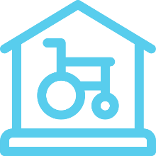
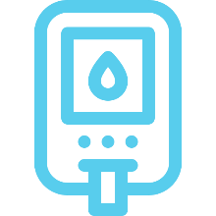
Our Durable Medical Equipment (DME), Supplies & Service
SMS is different from a typical medical supplies store. We venture in a new way of bringing the right supplies and equipment to your satisfaction.
DME
Assistive Devices
Mobility Devices
Emergency Devices
A wide selection of Home Medical Supplies following specifications.
Assistive, adaptive, and rehabilitative devices
Personal Mobility Device (PMD) Smart Mobility
Personal Emergency Response devices, AED, CPR and First Aid Kits
Diabetic Supplies
Orthotics
Health Monitoring
Knee Scooter & Wheelchair Rentals
Diabetes monitoring and self-management kits.
For a healthy Joint: Brace, Limb, Prosthetics, and Orthotics.
Medical alert systems, used for Heart, Gut, Blood sugar, and sleep
carbohydrates, proteins, and lipids containing nutrition products.

Slide 5
We are more Open store in the area.
We Check your supplies for emergency care.
We Also are good help to improve your Clinical Operations speed.
DME Selection Assist
Bathroom & Safety
Equipment Rentals
Emergency Devices Sales
Visit us at
8340 Northfield Blvd unit 1680,
Denver, CO 80238 during working hours.

